Slide 1
HNDIT2301: Operating System and Information Security
Hashing and Authentication
2 Basic cryptography - Part 4

Slide 2
Message Authentication
message authentication is concerned with:
  protecting the integrity of a message
  validating identity of originator
  non-repudiation of origin (dispute resolution)
will consider the security requirements
then three alternative functions used:
  message encryption
  message authentication code (MAC)
  hash function
Notes:
Up untill now, have been concerned with protecting message content (ie secrecy) by encrypting the message. Will now consider how to protect message integrity (ie protection from modification), as well as confirming the identity of the sender. Generically this is the problem of message authentication, and in eCommerce applications is arguably more important than secrecy. Message Authentication is concerned with: protecting the integrity of a message, validating identity of originator, & non-repudiation of origin (dispute resolution). There are three types of functions that may be used to produce an authenticator: message encryption, message authentication code (MAC), or a hash function.

Slide 3
Security Requirements
disclosure
traffic analysis
masquerade
content modification
sequence modification
timing modification
source repudiation
destination repudiation
Notes:
In the context of communications across a network, the attacks listed above can be identified.
The first two requirements belong in the realm of message confidentiality, and are handled using the encryption techniques already discussed.
The remaining requirements belong in the realm of message authentication. At its core this addresses the issue of ensuring that a message comes from the alleged source and has not been altered. It may also address sequencing and timeliness. The use of a digital signature can also address issues of repudiation by the source.

Slide 4
Message Encryption
message encryption by itself also provides a measure of authentication
if symmetric encryption is used then:
  receiver know sender must have created it
  since only sender and receiver now key used
  know content cannot of been altered
  if message has suitable structure, redundancy or a checksum to detect any changes
Notes:
Message encryption by itself can provide a measure of authentication. Here, the ciphertext of the entire message serves as its authenticator, on the basis that only those who know the appropriate keys could have validly encrypted the message. This is provided you can recognize a valid message (ie if the message has suitable structure such as redundancy or a checksum to detect any changes).

Slide 5
Message Encryption
if public-key encryption is used:
  encryption provides no confidence of sender
  since anyone potentially knows public-key
  however if
    sender signs message using their private-key
    then encrypts with recipients public key
    have both secrecy and authentication
  again need to recognize corrupted messages
  but at cost of two public-key uses on message
Notes:
With public-key techniques, can get a digital signature which can only have been created by key owner. But at cost of two public-key operations at each end on message.

Slide 6
Message Authentication Code (MAC)
generated by an algorithm that creates a small fixed-sized block
  depending on both message and some key
  like encryption though need not be reversible
appended to message as a signature
receiver performs same computation on message and checks it matches the MAC
provides assurance that message is unaltered and comes from sender
Notes:
An alternative authentication technique involves the use of a secret key to generate a small fixed-size block of data, known as a cryptographic checksum or MAC that is appended to the message. This technique assumes that two communicating parties, say A and B, share a common secret key K. A MAC function is similar to encryption, except that the MAC algorithm need not be reversible, as it must for decryption.

Slide 7
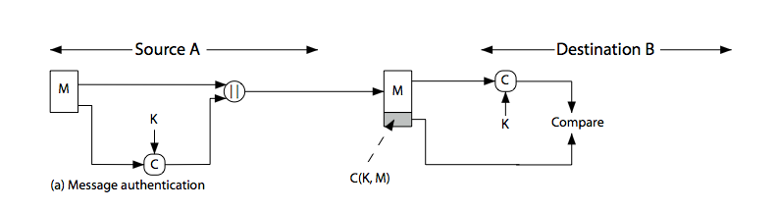
Message Authentication Code
Notes:
Stallings Figure 11.4a “Message Authentication” shows the use of a MAC just for authentication.

Slide 8
Message Authentication Codes
as shown the MAC provides authentication
can also use encryption for secrecy
  generally use separate keys for each
  can compute MAC either before or after encryption
  is generally regarded as better done before
why use a MAC?
  sometimes only authentication is needed
  sometimes need authentication to persist longer than the encryption (eg. archival use)
note that a MAC is not a digital signature
Notes:
Can combine use of MAC with encryption in various ways to provide both authentication & secrecy.
Use MAC in circumstances where just authentication is needed (or needs to be kept), see text for examples.
A MAC is NOT a digital signature since both sender & receiver share key and could create it.

Slide 9
MAC Properties
a MAC is a cryptographic checksum
  MAC = C_{K}(M)
  condenses a variable-length message M
  using a secret key K
  to a fixed-sized authenticator
is a many-to-one function
  potentially many messages have same MAC
  but finding these needs to be very difficult
Notes:
A MAC, also known as a cryptographic checksum,is generated by a function C. The MAC is appended to the message at the source at a time when the message is assumed or known to be correct. The receiver authenticates that message by re-computing the MAC.
The MAC function is a many-to-one function, since potentially many arbitrarily long messages can be condensed to the same summary value, but don’t want finding them to be easy!

Slide 10
Requirements for MACs
taking into account the types of attacks
need the MAC to satisfy the following:
  knowing a message and MAC, is infeasible to find another message with same MAC
  MACs should be uniformly distributed
  MAC should depend equally on all bits of the message
Notes:
In assessing the security of a MAC function, we need to consider the types of attacks that may be mounted against it. Hence it needs to satisfy the listed requirements.
The first requirement deals with message replacement attacks, in which an opponent is able to construct a new message to match a given MAC, even though the opponent does not know and does not learn the key.
The second requirement deals with the need to thwart a brute-force attack based on chosen plaintext.
The final requirement dictates that the authentication algorithm should not be weaker with respect to certain parts or bits of the message than others.

Slide 11
Hash Functions
condenses arbitrary message to fixed size
  h = H(M)
usually assume that the hash function is public and not keyed
hash used to detect changes to message
can use in various ways with message
most often to create a digital signature
Notes:
A variation on the message authentication code is the one-way hash function. As with the message authentication code, a hash function accepts a variable-size message M as input and produces a fixed-size output, referred to as a hash code H(M). Unlike a MAC, a hash code does not use a key but is a function only of the input message. The hash code is also referred to as a message digest or hash value.

Slide 12
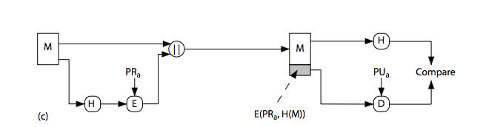
Hash Functions & Digital Signatures
Notes:
Stallings Figure 11.5c “Basic Uses of Hash Functions” shows the hash being “signed” with the senders private key, thus forming a digital signature.

Slide 13
Requirements for Hash Functions
can be applied to any sized message M
produces fixed-length output h
is easy to compute h=H(M) for any message M
given h is infeasible to find x s.t. H(x)=h
  one-way property
given x is infeasible to find y s.t. H(y)=H(x)
is infeasible to find any x,y s.t. H(y)=H(x)
Notes:
The purpose of a hash function is to produce a “fingerprint”of a file, message, or other block of data.
These are the specifications for good hash functions. Essentially it must be extremely difficult to find 2 messages with the same hash, and the hash should not be related to the message in any obvious way (ie it should be a complex non-linear function of the message). There are quite a few similarities in the evolution of hash functions & block ciphers, and in the evolution of the design requirements on both.

Slide 14
Simple Hash Functions
are several proposals for simple functions
based on XOR of message blocks
not secure since can manipulate any message and either not change hash or change hash also
need a stronger cryptographic function (next chapter)
Notes:
All hash functions operate using the following general principles. The input (message, file,etc.) is viewed as a sequence of n-bit blocks, processed one block at a time in an iterative fashion to produce an n-bit hash function. Can construct a range of possible simple hash functions by just XOR’ing blocks with rotates etc. None of these are secure, since can predict how changes to message affect the resulting hash.

Slide 15
Authentication
Authentication gives the assurance of whether a person/ object/ entity is exactly what he/it claims to me or is he/it is forged
Message Authentication Code, Hashing provides better ways of making this assurance
Authentication is the process of assuring Information Integrity

Slide 16
Authentication Models
What user knows
  a Password, A Personal Identification Number (PIN), etc.,
What user has
  smart card, token, etc,.
What user is
  Finger print, Retina, Palm print, Iris, DNA, etc.,

Slide 17





Three Factor Authentication

